Slide 1
Case Study in Statistical Learning
The Impact of Combinations of Anticancer Drugs
WANG, Chuning

Slide 2
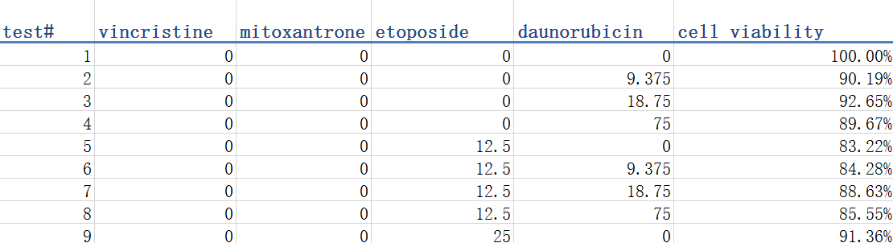
Dataset

Slide 3
Data Processing

Slide 4

Normalization
Feature Scaling
$${X_{i}}^{′}= \frac{X_{i} − X_{i min}}{X_{i max}− X_{i min}}$$
Studentized Residual
$$X_{i}^{′}=\frac{X_{i} − \overline{X}}{S}$$

Slide 5
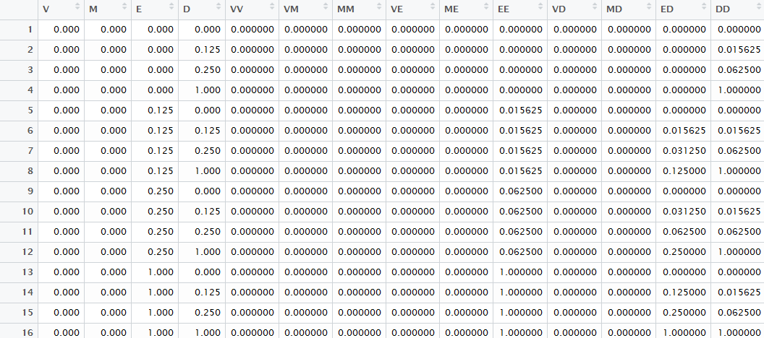
Adding Variables

Slide 6
Cross-Validation
Randomly select 32 groups of data as testing data, else as training data.
Reselect testing data and redo the whole process for ten times and compare the results.

Slide 7
Statistical Learning Models

Slide 8
Quadratic Regression
Ridge Regression
Lasso Regression
Multi-Layer Perceptron neural network (MLP)
Random Forest

Slide 9

Quadratic Regression
Linear regression of the 14 terms
Estimates coefficients $\hat{β}$ minimizing $\sum_{i=1}^{n}{{(y_{i}−β_{0}−\sum_{j=1}^{p}{β_{j}x_{ij}})}^{2}}$

Slide 10

Ridge Regression
Estimates coefficients ${\hat{β}}^{R}$ minimizing $\sum_{i=1}^{n}{{ (y_{i}−β_{0}−\sum_{j=1}^{p}{β_{j}x_{ij}})}^{2}}+λ\sum_{j=1}^{p}{β_{j}^{2}}$
$λ≥0$: tuning parameter
Apply 8-folds cross-validation to training data to determine the value of $λ$ minimizing mean squared error (MSE).
Negative $β_{j}$: Positive effect on killing cancer cells. Lower the value $β_{j}$ takes, better the efficacy is. Especially for the cross terms, such as VM, VE, positive $β_{j}$ means that the two kinds of drugs reject each other, and negative $β_{j}$ means that they cooperate well with each other on treating the cancer.

Slide 11

Lasso Regression
Estimates coefficients ${\hat{β}}^{L}$ minimizing $\sum_{i=1}^{n}{{(y_{i}−β_{0}−\sum_{j=1}^{p}{β_{j}x_{ij}})}^{2}}+λ\sum_{j=1}^{p}{\left|β_{j}\right|}$
$λ≥0$: tuning parameter
Determine $λ$ minimizing mean squared error (MSE)
Determine $λ$ giving a sparse model.
The way to interpret the model is similar to the case of Ridge regression.

Slide 12
Multi-Layer Perceptron neural network (MLP)
Structure of a Single Perceptron
Adopt sigmoid function as activation function here.

Slide 13

Multi-Layer Perceptron neural network (MLP)
Structure of MLP with Single Hidden Layer
Back propagation algorithm is used to adjust weights to minimize the error $E=\frac{1}{2}{\left\|y−d\right\|}_{2}$

Slide 14

Random Forest
Decision Tree: A flowchart-like structure classifier.
Construct 100 decision trees, each only taking into consideration a random subset of $m$ samples from the full set of samples.
Make Prediction: Random forest takes the mean of predictions of each tree as output.

Slide 15
Results

Slide 16
Quadratic Regression
Feature Scaling: V performs best, followed by M, E, VM, D.
Studentized Residual: V performs best, followed by E, D, M, VM.

Slide 17
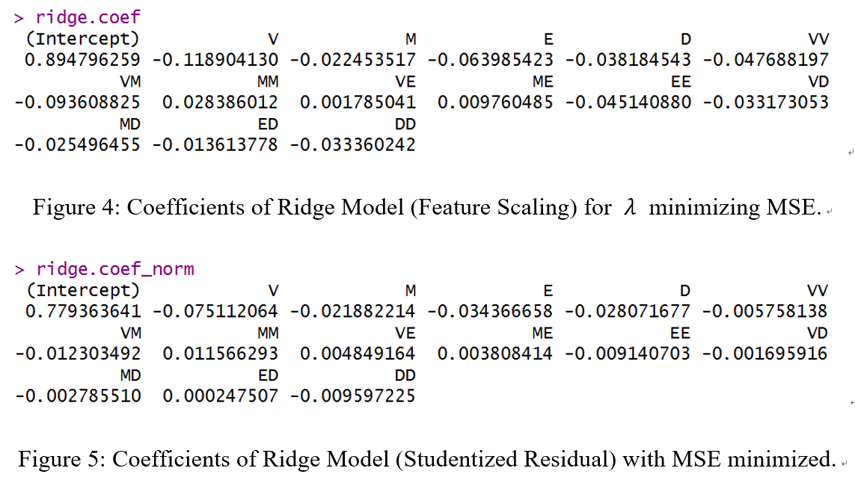
Ridge Regression
V, VM, E, VV, EE
V, E, D, M, VM

Slide 18
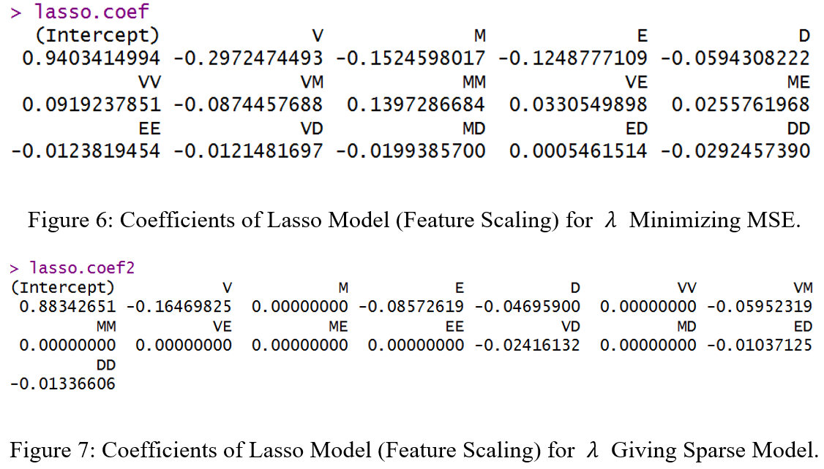
Lasso Regression
V, M, E, VM, D
V, E, VM, D, VD, DD, ED

Slide 19
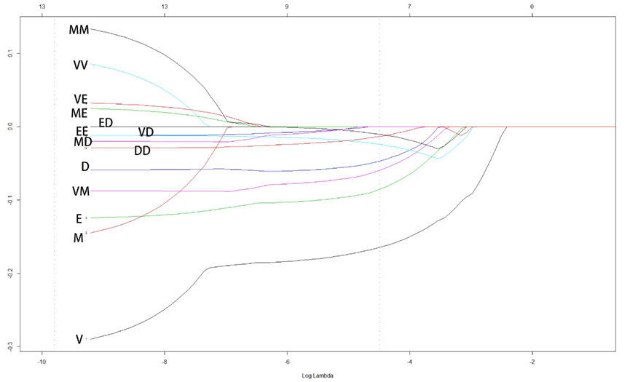
Lasso Regression
V, VD, E, ED, VM, D, DD, EE, MD, MM, VE, ME, M, VV
λ minimizing MSE
λ giving sparse model

Slide 20
Lasso Regression

Slide 21
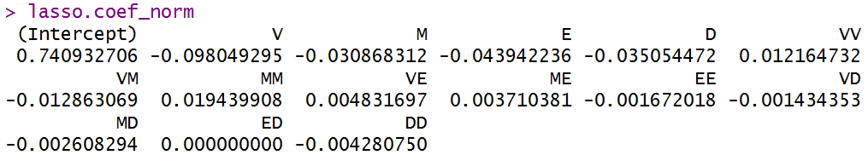
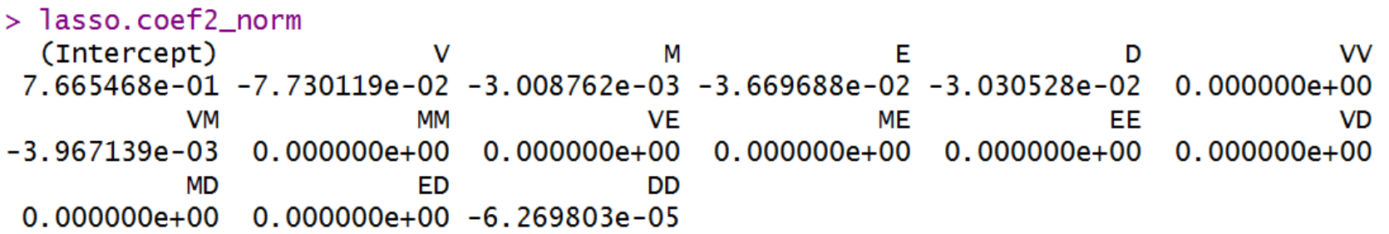

Lasso Regression
V, E, D, M, VM
Figure 10: Coefficients of Lasso Model (Studentized Residual) for $λ$ minimizing mean squared error (MSE).
V, E, D, VM, M, DD
Figure 11: Coefficients of Lasso Model (Studentized Residual) for the Sparse Model

Slide 22
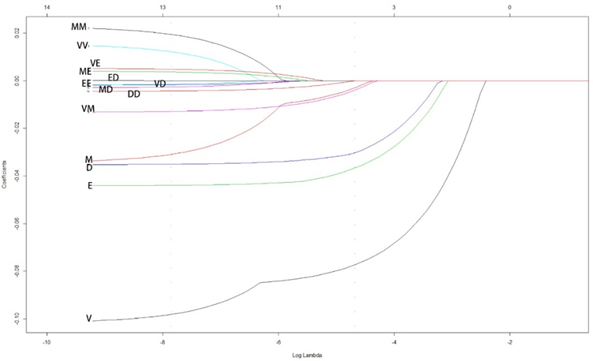
Lasso Regression
λ minimizing MSE
λ giving sparse model

Slide 23
Multi-Layer Perceptron neural network (MLP)
Figure 13: The Importance of Inputs in MLP with Feature Scaling.

Slide 24
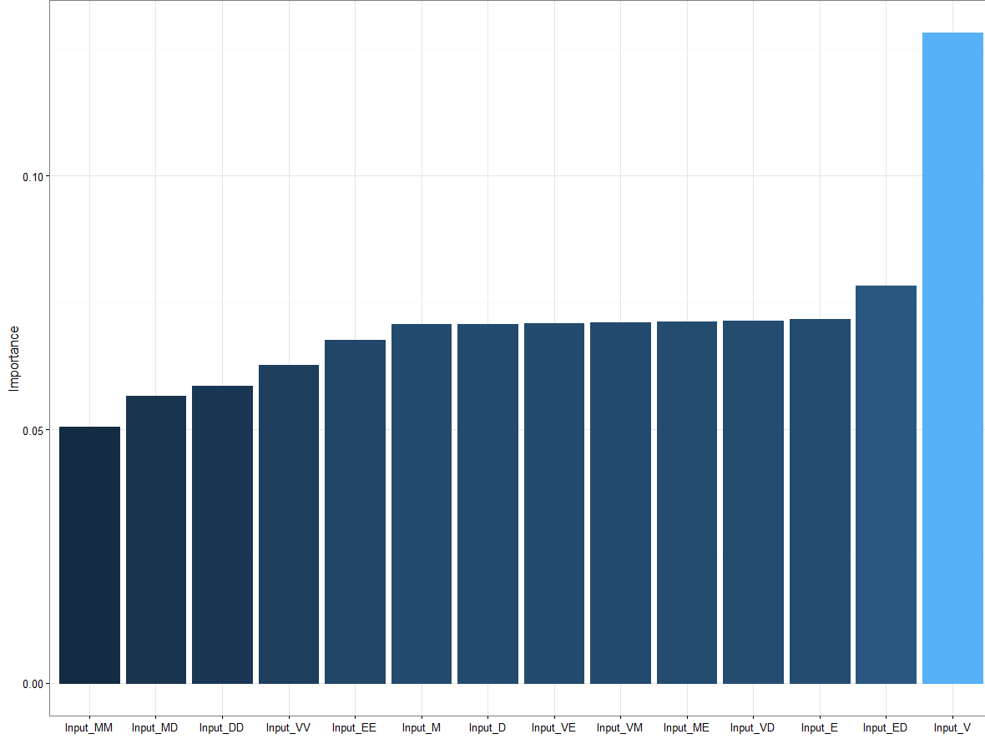
Multi-Layer Perceptron neural network (MLP)
Figure 14: The Importance of Inputs in MLP with Studentized Residual.

Slide 25
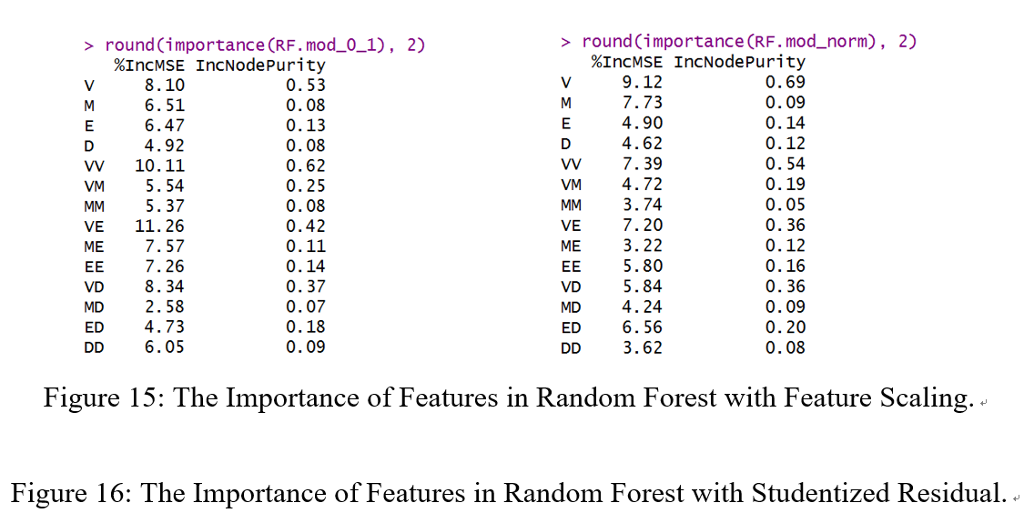
Random Forest

Slide 26
Performance of the Models

Slide 27
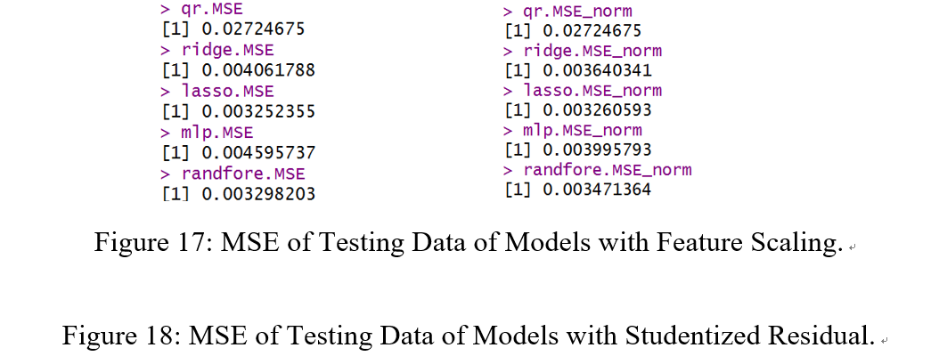
Mean Squared Error

Slide 28

Cross-Validation
Retraining Random Forest with feature scaling for ten times, VE, VV, VD, and V always outperforms other terms considering importance.
As for Lasso models with feature scaling , the models at $λ$ minimizing MSE always give that V, M, E, VM, and D performs better than others. The coefficients of VE and ME are always positive. And the coefficient of MM is always about 0.13 and suggests that if we give too much Mitoxantrone, cell viability may even be increasing.

Slide 29
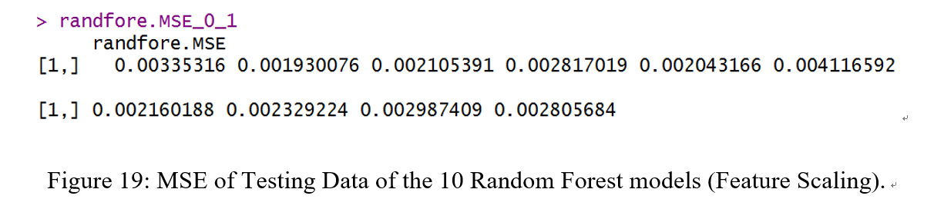
Cross-Validation
MSE is stably small.

Slide 30
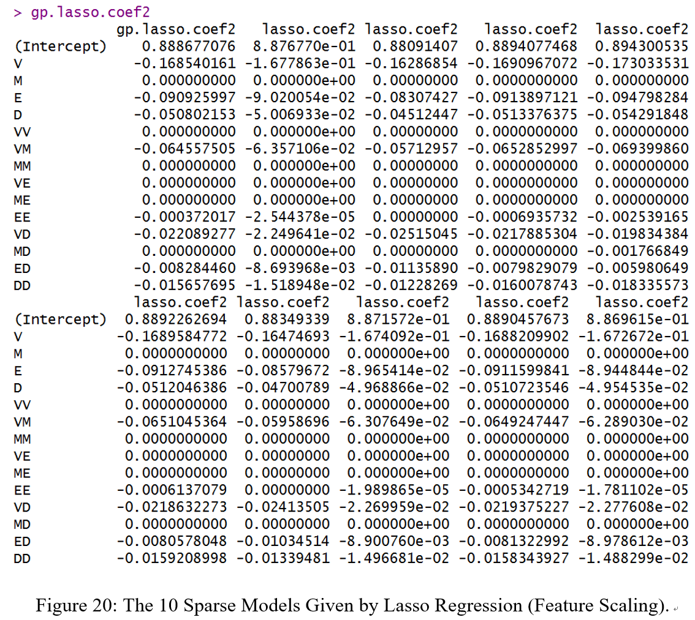
Cross-Validation

Slide 31
Conclusion

Slide 32
Random forest and Lasso regression performs quite well at capturing the pattern of the impact of combination of medicines on cell viability.
VM may be a candidate for more effective therapy against leukemia.
The combination of Etoposide with Mitoxantrone or Vincristine may not work well. And the excessive use of Mitoxantrone may result in lower efficacy on treating leukemia.
Remaining Problem: the results of different models may disagree with each other in some way.

Slide 33
Further Improvement
Data Processing
-Take only cross terms as input
-Higher order approximation
Model
-Combine Ridge and Lasso
Interesting Phenomena:
-Variation of the coefficient of ED

Slide 34
Thank you!
Q&A

